Slide 1
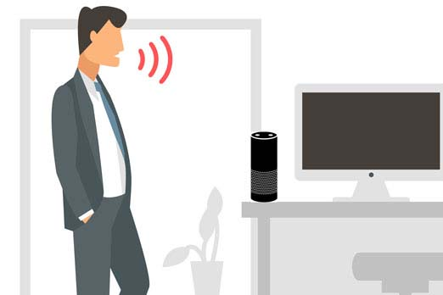
Project Teemo
By Patrick Ng n01104570

Slide 2

Introduction
Project Teemo is a voice interface system that connects to Amazon personal assistance service called Alexa and perform various tasks via voice commands.
Intended to make everyday tasks easier.
Example: Making Lists, Checking Weather, Simple Mathematics, Time and etc.

Slide 3
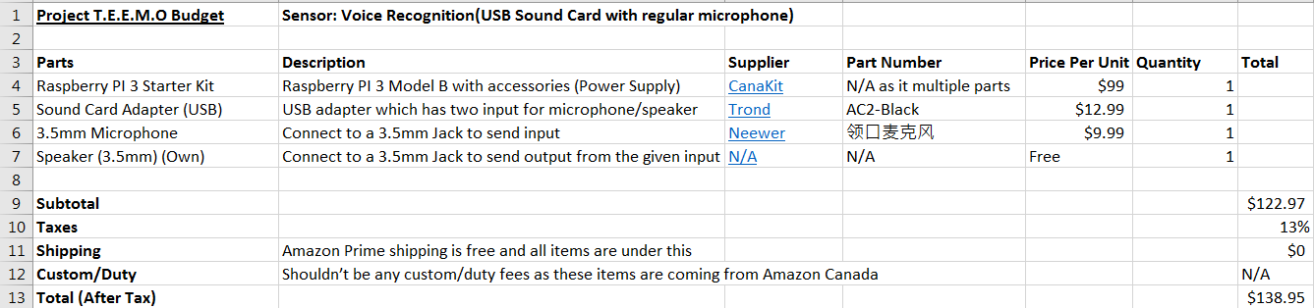
Project Budget

Slide 4

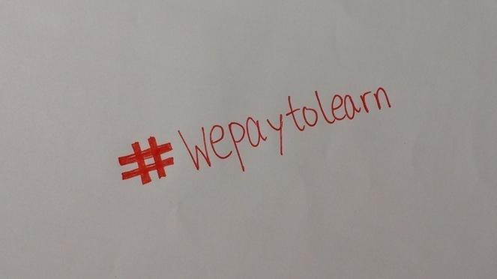
Project Schedule
During Mid - October, the college faculties went on strike dues to not being able to come to an agreement on their contracts.
Dues to the strike, the project schedule was modified to fit the new semester schedule that was created after the strike has ended.
The project progress has not been changed dues to the strike and will be completed on time to the new schedule.

Slide 5
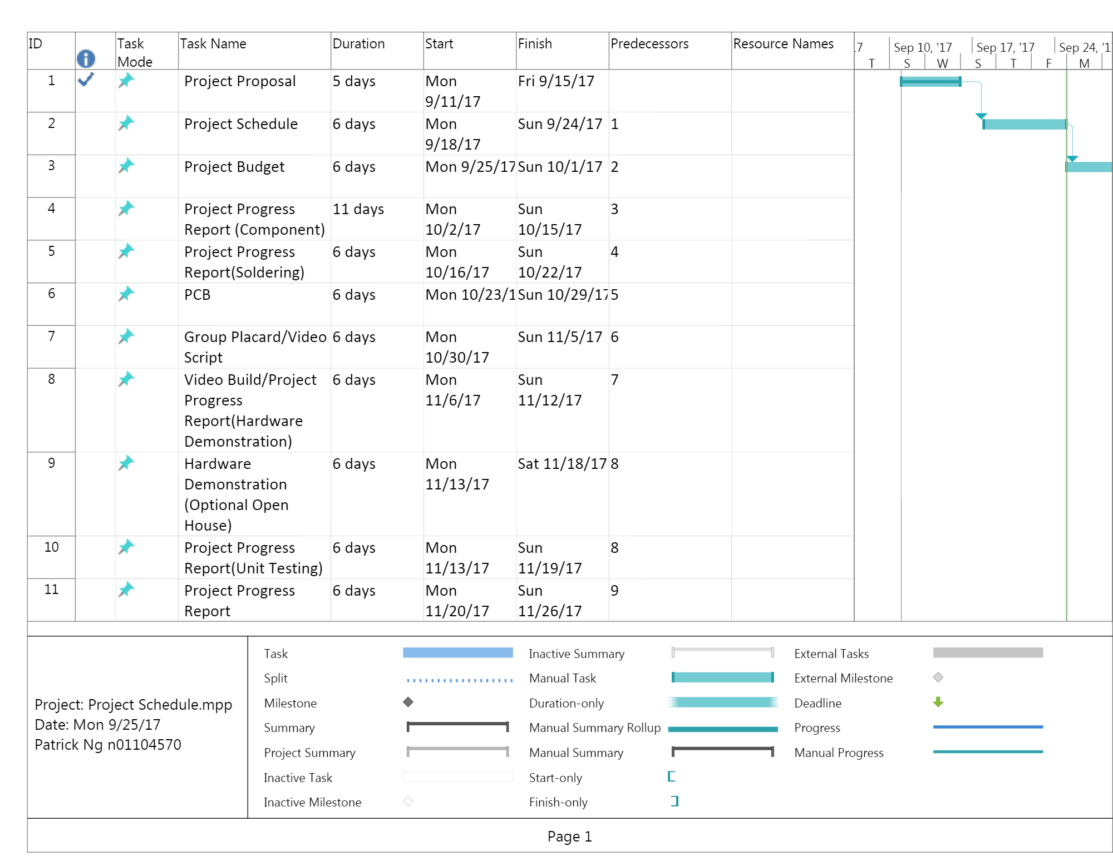
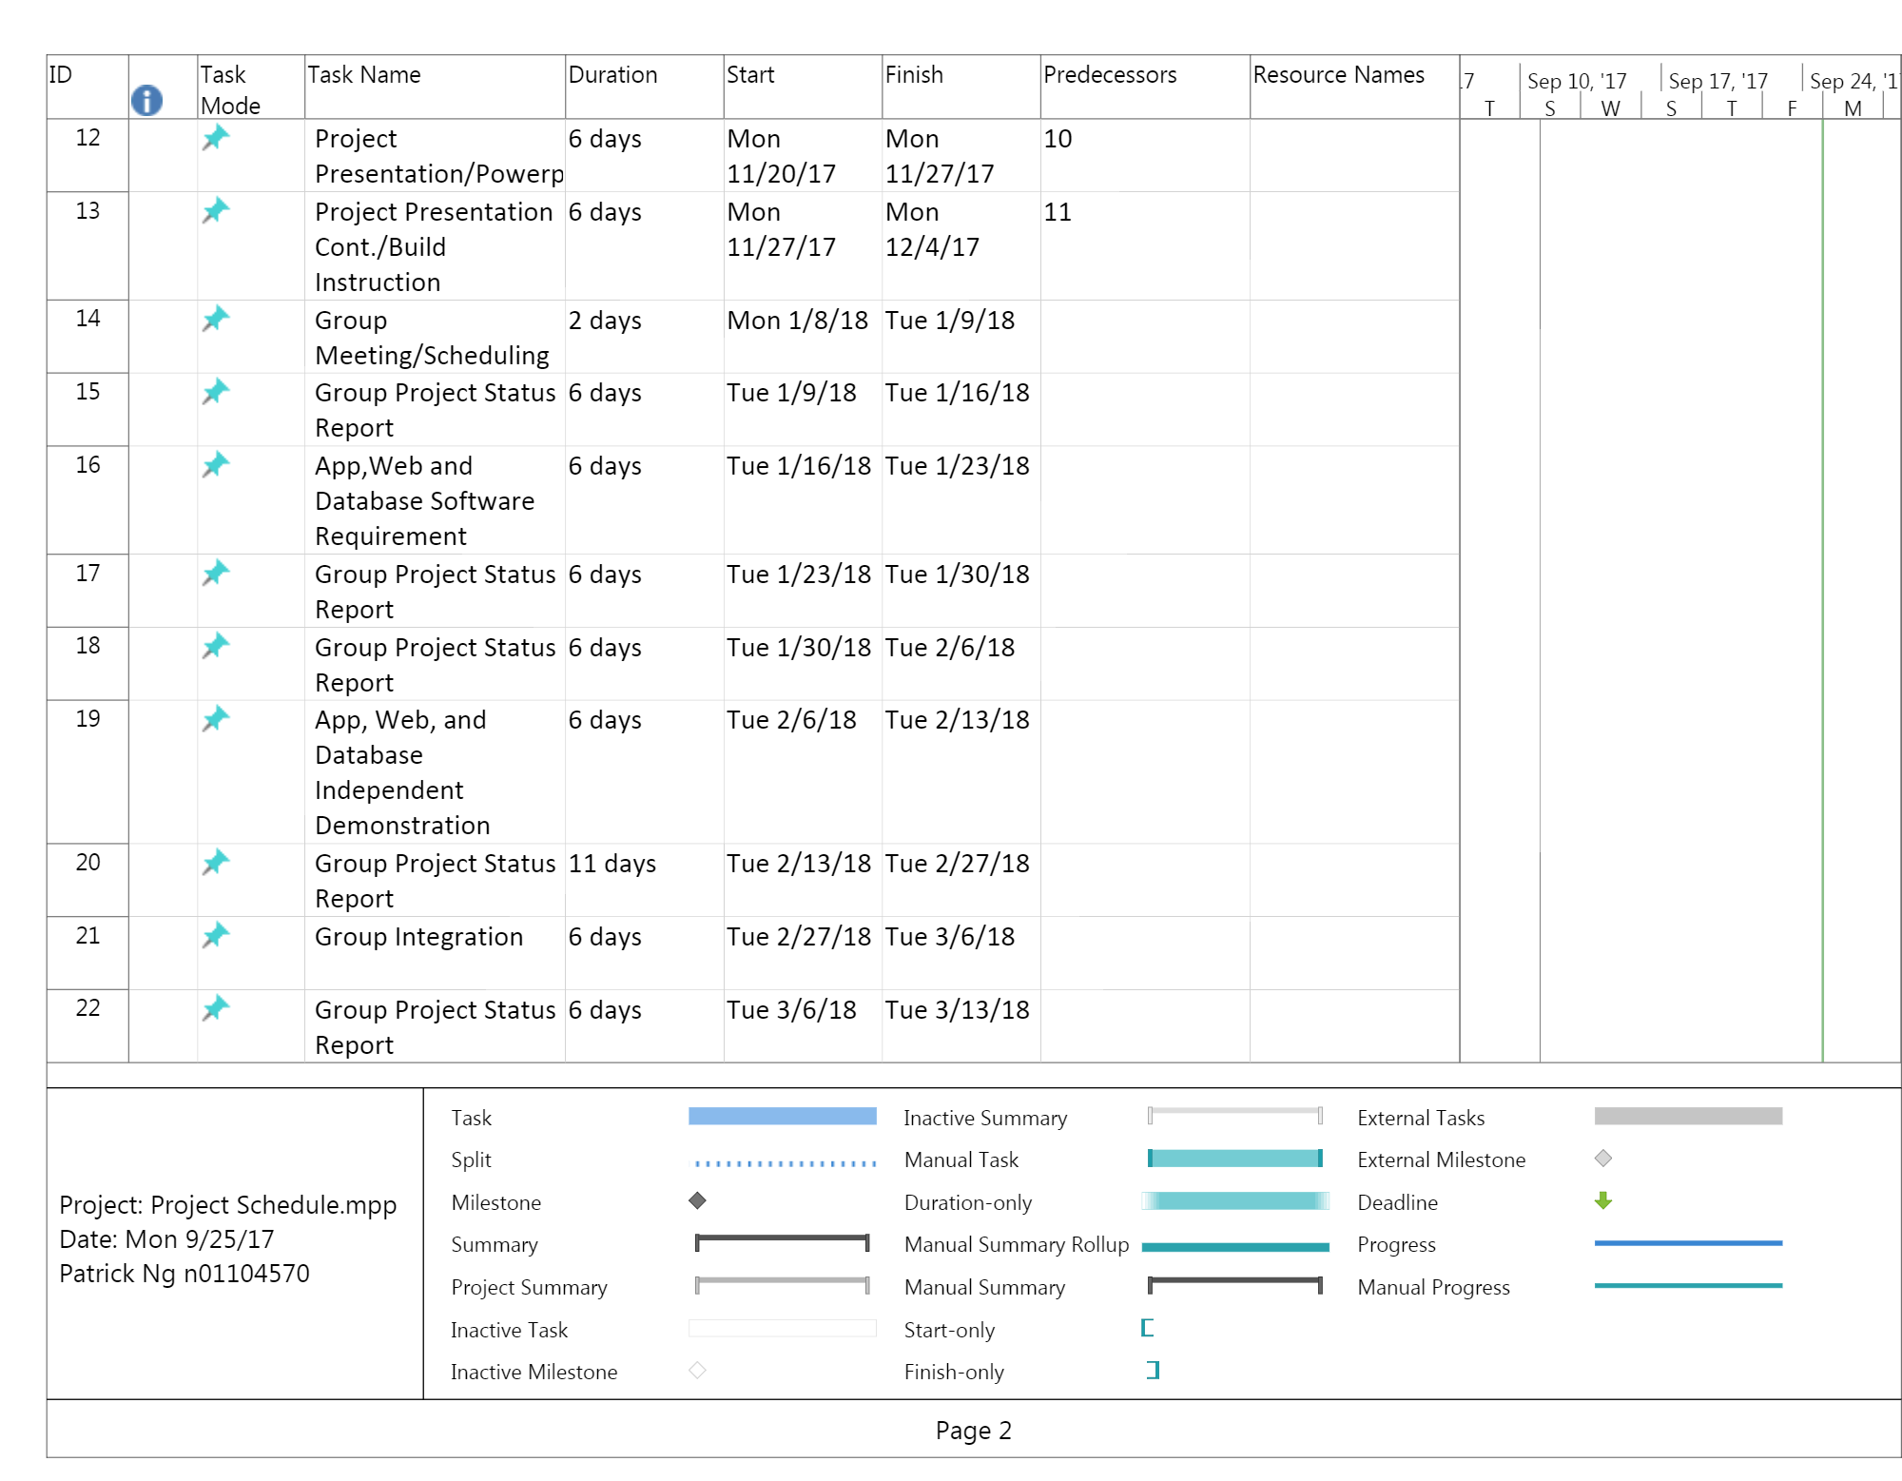
Project Schedule Cont.

Slide 6
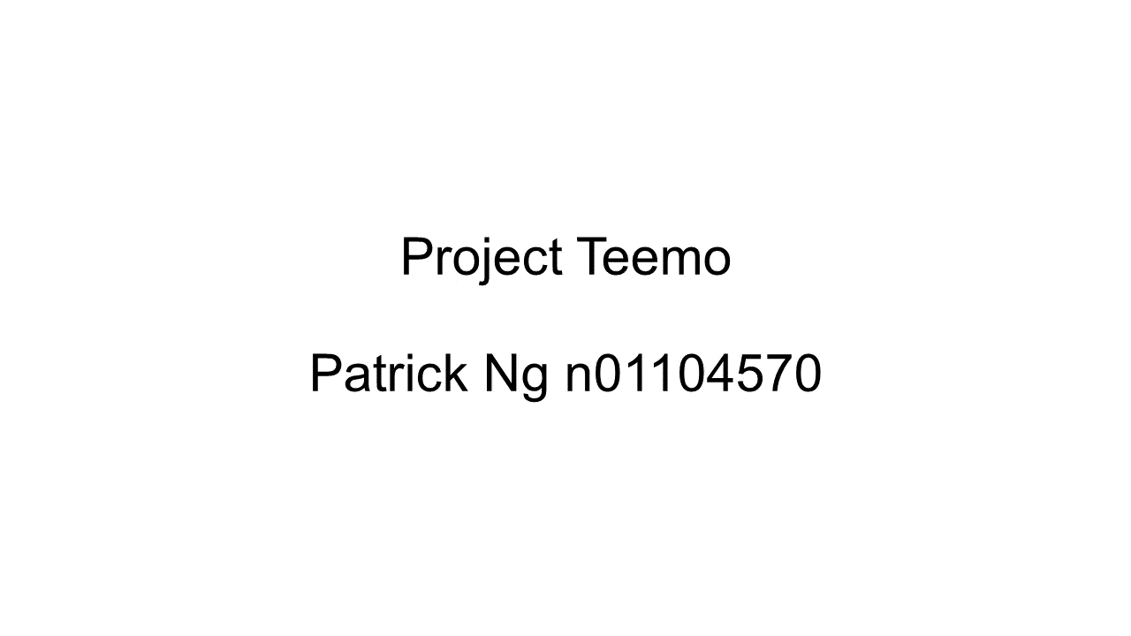
Build Video/Live Demo

Slide 7
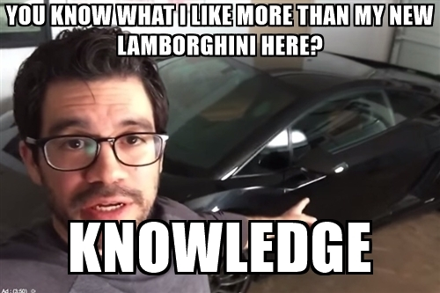
Previous Course Knowledge
Unix Scripting – Linux Command Line Usage
Intro to Software Engineering – Project Planning / Development Cycle
Database in Java – Database Creation/Manipulation
Programming Technique in Java – Programming in Java

Slide 8

The End

